Slide 1
Objectives
  In this lesson, you will learn about:
    Evolution of distributed applications
    Components and architecture of RMI
    Classes and interfaces of RMI packages
    Steps to create and host RMI application

Slide 2
Overview of Distributed Application
  The approaches to develop a distributed application are:
    Traditional
    Client/Server
    Component-based

Slide 3
Overview of Distributed Application (Contd.)
  In the traditional approach of developing a distributed application:
    A single application handles the presentation logic, business logic and database interactivity.
    These application are also called monolithic applications.
    You need to recompile and integrate the entire application, if you want to change, extend or enhance the application created using traditional approach.

Slide 4
Overview of Distributed Application (Contd.)
  In the client/server approach of creating a distributed application:
    Data is centrally stored on the server.
    The business logic and presentation logic are combined together at client side or server side.
      fat client: Business logic and presentation logic are combined together at client side.
      fat server: Business logic and presentation logic are combined together at server side.
    Any change in the business policies requires a change in the business logic.
    It is difficult to scale-up the client because a client has a limited number of database connections.

Slide 5
Overview of Distributed Application (Contd.)
  In the component-based approach of creating a distributed application:
    The presentation logic resides at client-side.
    The business logic resides between the client and server and is known as middle-tier.
    The database access is controlled at the server-side.
    A database connection is established only when data access is required and is released as the data is retrieved or sent to the server.
    The applications run on the middle-tier and are independent of both the presentation interface and database implementation.

Slide 6
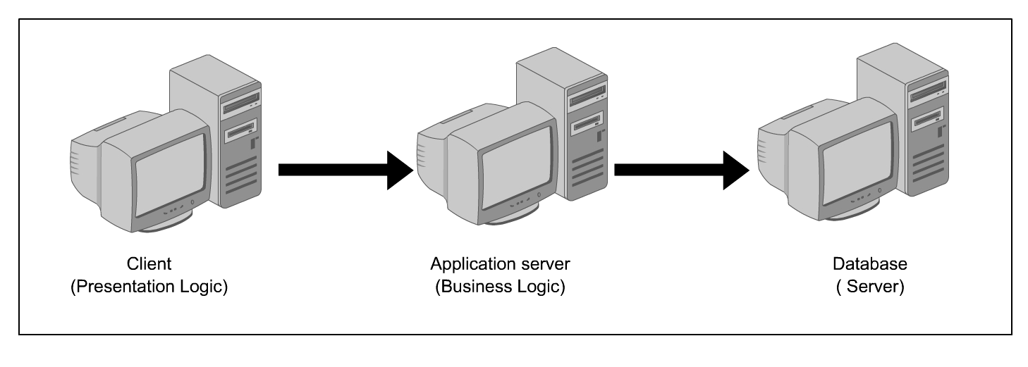
Overview of Distributed Application (Contd.)
  Three-tier distributed application

Slide 7
Remote Method Invocation
  RMI:
    Is an easy alternative to the complex coding involved in server-socket programming.
    Enables you to create distributed applications.
    Is a specification that enables one Java Virtual Machine (JVM) to invoke methods in an objcet located in another JVM.
    Is implemented on the middle-tier of the three-tier architecture framework.

Slide 8
Remote Method Invocation (Contd.)
  Components of RMI Application
    The two components of RMI application are:
      RMI server:
        Contains the objects whose methods are to be invoked remotely.
        Creates several remote objects and makes a reference of these objects in the RMI registry.
      RMI client:
        Gets the references of one or more remote objects from the RMI registry.
        Invokes the methods on the remote object to access the services of the remote object.

Slide 9
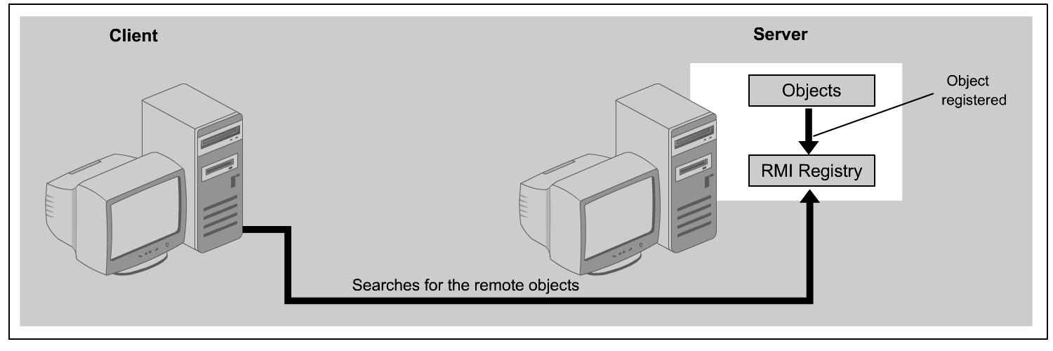
Remote Method Invocation (Contd.)
  Functionality of RMI application

Slide 10
Remote Method Invocation (Contd.)
  The RMI Architecture
    The three layers of RMI architecture are:
      Stub/Skeleton Layer
      Remote Reference Layer
      Transport Layer

Slide 11
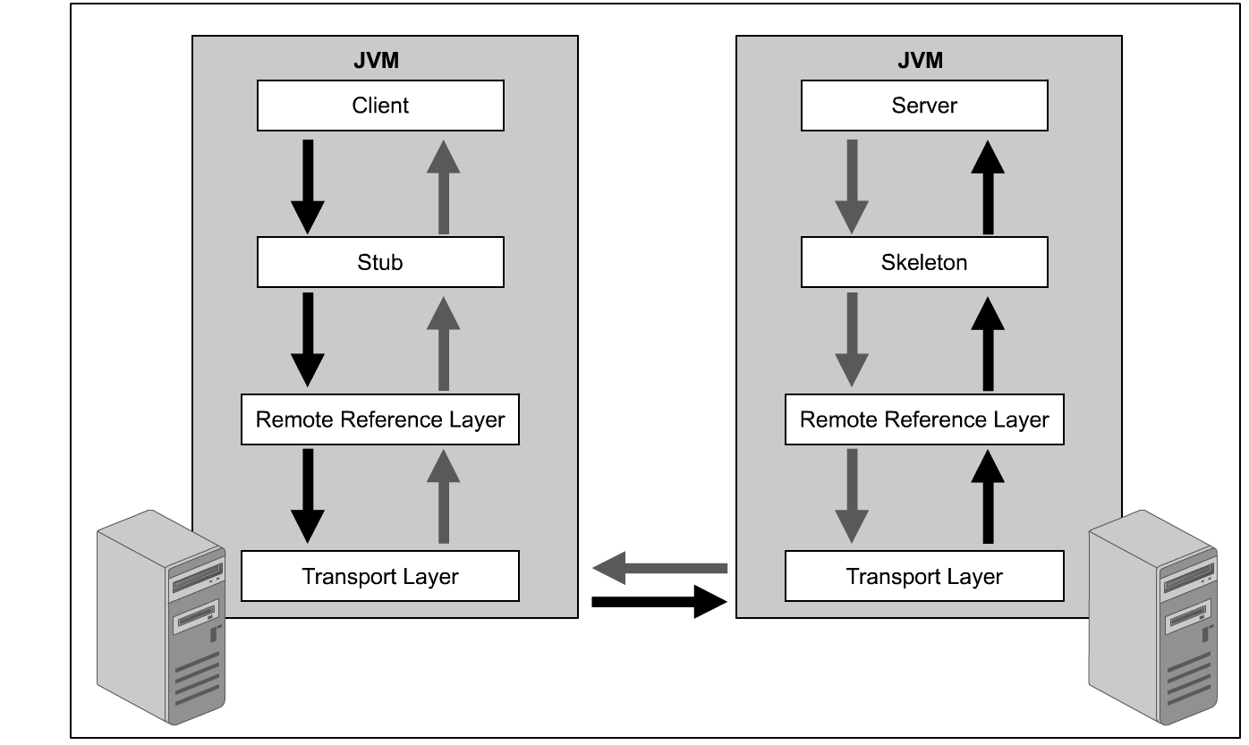
Remote Method Invocation (Contd.)
  RMI Architecture

Slide 12
Remote Method Invocation (Contd.)
  Stub/Skeleton Layer:
    Listens to remote method calls by a client and redirect these calls to the remote RMI services on the server.
    Consists of:
      Stub:
        Provides methods of the remote object.
        Communicates the method invocations to the remote object.
      Skeleton:
        Reads the parameter for the method call.
        Makes the call to the remote service implementation object.
        Accepts the return value.
        Writes the return value back to the stub.

Slide 13
Remote Method Invocation (Contd.)
  Remote Reference Layer:
    Interprets and manages the references made by a client to a remote object on the server.
    Contains:
      Client-side RRL
        Receives a request from a stub.
        Marshals the request.
        Sends the marshaled request stream to the server.
      Server-side RRL
        Unmarshals the parameter that are sent to a remote method.
        Returns the value back to the client.

Slide 14
Remote Method Invocation (Contd.)
  Transport Layer:
    Establish new connections and manages the existing connections between the client and server.
    Handles remote objects that resides in transport layer address space.
    Connects a client to the server using the following steps:
      Establishes a socket connection to the server through server-side RRL.
      Passes the established socket connection to the client-side RRL.
      Adds a remote reference to the connection in its reference table.

Slide 15
Remote Method Invocation (Contd.)
  RMI Packages
    The java.rmi package: Provides the Remote interface, a class for accessing the remote names registered on the server, and a security manager for RMI.
    The java.rmi.registry package: Provides classes and interfaces that are used by the remote registry.
    The java.rmi.server package: Provides classes and interfaces used to implement remote objects, stubs and skeletons, and support for RMI communication.
    The java.rmi.dgc package: Provides classes and interfaces that are used by the RMI-distributed garbage collector.

Slide 16
Remote Method Invocation (Contd.)
  The classes and interfaces of java.rmi package are:
    Remote interface
    Naming class
      rebind() method
      unbind() method
      lookup() method
      list() method
    RMISecurityManager class

Slide 17
Remote Method Invocation (Contd.)
  The classes and interfaces of java.rmi.registry package are:
    Registry interface
    RegistryHandler interface

Slide 18
Remote Method Invocation (Contd.)
  The classes and interfaces of java.rmi.server package are:
    RemoteObjcet class
    RemoteServer class
    UnicastRemoteObjcet class
    RemoteStub class
    RemoteCall interface
    Skeleton interface
    Unreferenced interface

Slide 19
Remote Method Invocation (Contd.)
  The classes and interfaces of java.rmi.dgc package are:
    Lease class
      dirty() method
      clean() method

Slide 20
Remote Method Invocation (Contd.)
  Distributed Garbage Collection
    Is a mechanism to automatically deletes the remote objects that RMI clients are not using.
    Uses the reference counting garbage collection algorithm to manage the references of the remote object.
    Uses the objects of the Lease class to keep the references of remote objects that reside in the JVM.

Slide 21
Creating a Distributed Application Using RMI
  The steps to create an RMI application are:
    Create a remote interface
    Implement a remote interface
    Create an RMI server
    Create an RMI client
    Run the RMI application

Slide 22
Creating a Distributed Application Using RMI (Contd.)
  Creating a Remote Interface
    Import the java.rmi package.
    Declare the remote interface with public identifier.
    Extend the java.rmi.Remote interface.
    Use the java.rmi.RemoteException class with every method that declared in the remote interface.
    The code snippet to create a remote interface is:
    import java.rmi.*;
    public interface Hello extends Remote
    {
      public String sayHello() throws RemoteException;
    }

Slide 23
Creating a Distributed Application Using RMI (Contd.)
  Implementing the Remote Interface
    Import the java.rmi and java.rmi.server packages.
    import java.rmi;
    import java.rmi.server;
    Create a remote service that implements the remote interface and extends the UnicastRemoteObject class.
    public class HelloImpl implements Hello extends UincastRemoteObjcet
    {
    ..
    ..
    }

Slide 24
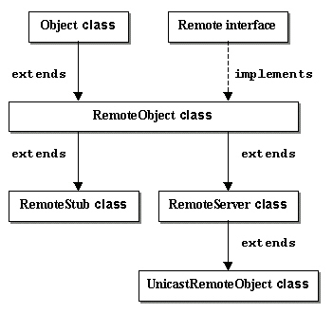
Creating a Distributed Application Using RMI (Contd.)
    Hierarchy of UnicastRemoteObjcet Class

Slide 25
Creating a Distributed Application Using RMI (Contd.)
    Define the default constructor of the remote service class.
    public HelloImpl() throws RemoteException
    {
    super();
    }
    Define the method that are declared in the remote interface.
    public String sayHello() throws RemoteException
    {
    return “Hello! Peter Smith.”;
    }

Slide 26
Creating a Distributed Application Using RMI (Contd.)
  Creating an RMI Server
    Create the object of the remote service class in the main() method of the RMI server class.
    Hello h = new HelloImpl();
    Register the server object in the bootstrap registry before the server object is ready to accept request from the client.
    Naming.rebind("server",h);
    Create and install the security manager for the RMI application:
    System.setSecurityManager(new RMISecurityManager());

Slide 27
Creating a Distributed Application Using RMI (Contd.)
  Creating the Security Policy File
    Type the command, policytool, on command prompt to display the Policy Tool utility of Java. The Policy Tool window is displayed with an Error dialog box.

Slide 28
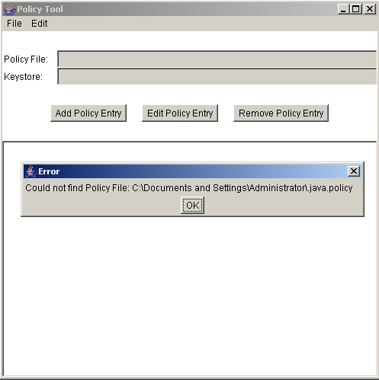
Creating a Distributed Application Using RMI (Contd.)
    Policy Tool Window

Slide 29
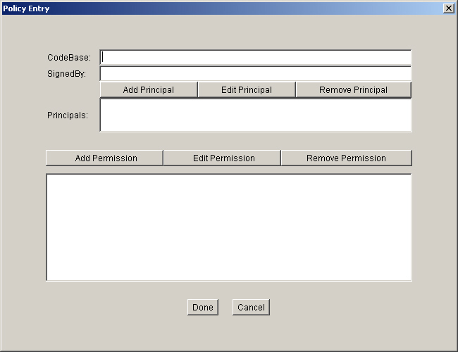
Creating a Distributed Application Using RMI (Contd.)
    Click the OK button of the Error dialog box. Now, click the Add Policy Entry button to add a new security policy file. This displays the Policy Entry dialog box as shown:

Slide 30
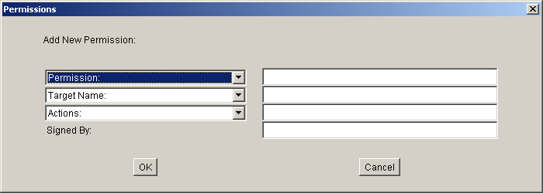
Creating a Distributed Application Using RMI (Contd.)
    Click the Add Permission button to grant the required permission to access the resources of the server by the client. The following figure shows the Permissions dialog box:

Slide 31

Creating a Distributed Application Using RMI (Contd.)
    Select AllPermission from the Permission list box of the Permissions dialog box.
    Click the OK button to close the Permissions dialog box.
    Click the Done button of the Policy Entry dialog box.
    Select the File→Save As command of the Policy Tool window to save the new security policy.
    Save the security policy file as .java.policy in the HOME directory of the operating system. A confirmation message is displayed on the Status dialog box. The following figure shows the Status message box:

Slide 32
Creating a Distributed Application Using RMI (Contd.)
    Click the OK button of the Status message box.
    Select the File→Exit command of the Policy Tool window to close the Policy Tool utility of Java.

Slide 33
Creating a Distributed Application Using RMI (Contd.)
  Creating an RMI Client
    Find the stub object by specifying the name of the server object as a parameter in the lookup() method.
    Hello h = (Hello)Naming.lookup("rmi://192.168.0.52/server");
  Running the RMI Application
    Generate the stub and skeleton of the remote service class.
    Start the RMI registry.
    Run the RMI server.
    Run the RMI client.

Slide 34
Creating a Distributed Application Using RMI (Contd.)
  Generating the Stub and Skeleton
    The command to generate the stub and skeleton is:
  rmic [Option] <ClassFile>
    The following table lists the various options of RMI compiler:
Options | Description
-bootclasspath <path> | Overrides the location of the bootstrap class file.
-classpath <path> | Overrides the default classpath environment variables.
-d <directory> | Specifies the name of the directory where you want to generate the stub and skeleton.

Slide 35
Creating a Distributed Application Using RMI (Contd.)
    Options of RMI compiler (Contd.)
Options | Description
-depend | Compiles all the files that are referenced to the remote service class.
-extdirs <path> | Overrides the location of the installed extensions.
-g | Generates the line numbers and local variables in the form of a table.
-keep | Stores '.java' file that generates the stub and skeleton.
-nowarn | Does not display any warning when you generate the stub and skeleton.

Slide 36
Creating a Distributed Application Using RMI (Contd.)
    Options of RMI compiler (Contd.)
Options | Description
-vcompat | Creates stub and skeleton that are compatible with earlier versions of RMI protocols.
-verbose | Display a message, when the remote service file is compiled by rmic.
-v <version> | Create a stub and skeleton for the specified versions of the Java Development Kit (JDK).

Slide 37
Creating a Distributed Application Using RMI (Contd.)
  Starting the RMI Registry
    The command to start the RMI registry at specified port number(1234) is:
  start rmiregistry 1234
    The command to start the RMI registry at default port number (1099) is:
    start rmiregistry

Slide 38
Creating a Distributed Application Using RMI (Contd.)
  Running an RMI Server
    The command to run the RMI server is:
  java HelloServer
  Running an RMI Client
    The command to run the RMI client is:
    java HelloClient

Slide 39
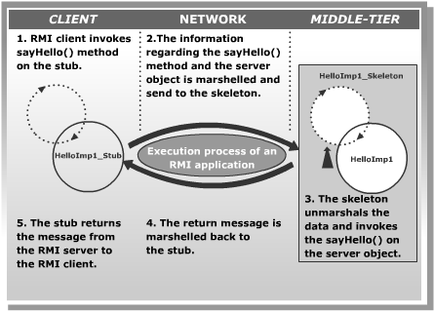
Creating a Distributed Application Using RMI (Contd.)
  Working of RMI Application

Slide 40
Demonstration-Implementing an RMI Application
  Problem Statement
    Earnest publishing house has branches in all major cities across the globe. They have a central database in Chicago. The publishing house wants to create an application that will allow its authors to register with the publishing house. The details submitted by the authors needs to be updated in the database server.

Slide 41
Demonstration-Implementing an RMI Application (Contd.)
  Solution
    The steps to create the distributed application using RMI are:
      Create the AuthorServer remote interface.
      Create the AuthorServerImpl class.
      Create the Client class.
      Run the application.

Slide 42
Summary
In this lesson, you learned that:
  Distributed applications are applications that execute across multiple host systems.
  The RMI is implemented on the middle-tier of the three-tier architecture framework.
  RMI allows a client on one JVM to invoke an object of a method present on another JVM.
  The RMI architecture consists of three layers: the Stub/Skeleton Layer,the Remote Reference Layer, and the Transport Layer

Slide 43
Summary (Contd.)
  RMI consists of the following four packages:
    java.rmi: Provides classes and interfaces to access the remote objects using the name registered in the RMI registry.
    java.rmi.server: Provides classes and interfaces to implement remote interface and generate the stub/skeleton.
    java.rmi.registry: Provides classes and interfaces to register an object and access the object by a name across network.
    java.rmi.dgc: Provides classes for implementing distributed garbage collector.
  The registry is an RMI service that resides on the server and allows remote clients to get reference of a remote object.
  A remote interface declares the methods that can be invoked remotely by a client.

Slide 44
Summary (Contd.)
  A remote service class for the RMI server must:
    Implement a remote interface.
    Define a constructor in the remote service class to initialize a remote object.
    Provide implementation for remote method.
    Create and install the security manager.
    Instantiate a remote object.
    Register a remote object with the RMI registry.
  Java provides security to applications by using the security manager.

Slide 45
Summary (Contd.)
  The steps to create and run an RMI application are:
    Define the remote interface.
    Create a remote service class that implements the remote interface.
    Create an RMI server.
    Create an RMI client.
    Compile and generate the stub and skeleton.
    Start the RMI registry.
    Run the RMI server application.
    Run the RMI client application.

